Slide 1


A swarm of robots for encouraging desired social behaviors
Serge Saaybi
Thesis Status update report
TU Delft | 1 June 2021

Slide 2
Table of content
Implemented the for:
Perceiving Humans: from Monocular 3D Localization to Social Distancing
Started writing the software benchmarking part of the report (vision and navigation)
Worked on identifying the most adequate navigation algorithm and on trying to run some of the implementations I could find

Slide 3
Detecting breaches in social distancing
A camera mounted on a robot collects an input video sequence and passes it to a Deep Neural Network model. This model would then output the detected people either using bounding boxes or their skeleton.
Challenges to be considered are variations in clothes, pos­tures, at far and close distances, with/without occlusion, and under different lighting conditions
The identified methods are:
RGB­-D camera
RGB camera with calibration which is challenging as we would be mapping monocular images to 3D
RGB camera with an algorithm such as monoloco

Slide 4
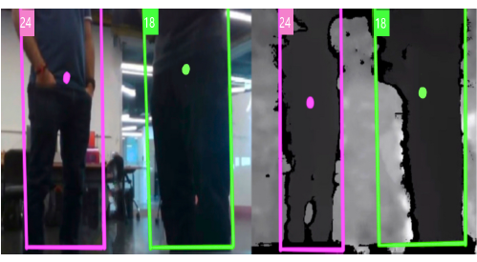
COVID-Robot: Monitoring Social Distancing Constraints in Crowded Scenarios
RGB­-D camera
Left: Two pedestrians detected in the RGB image of the robot’s RGB-D camera with the bounding box centroids marked in pink and green.
Right: The same bounding boxes superimposed over the depth image from the RGB-D camera. The pedestrians are localized and the distance between them is estimated

Slide 5
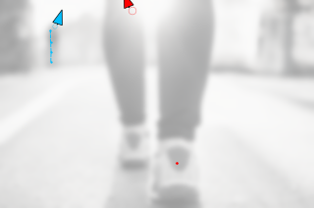
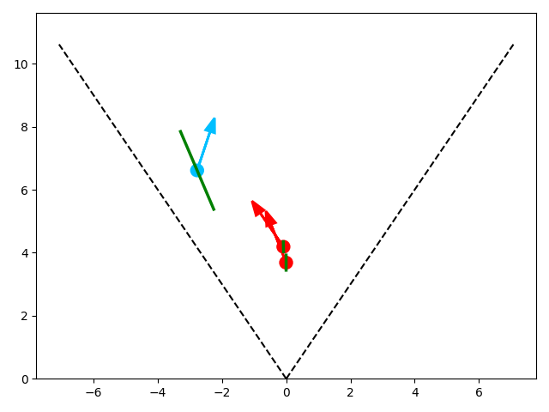
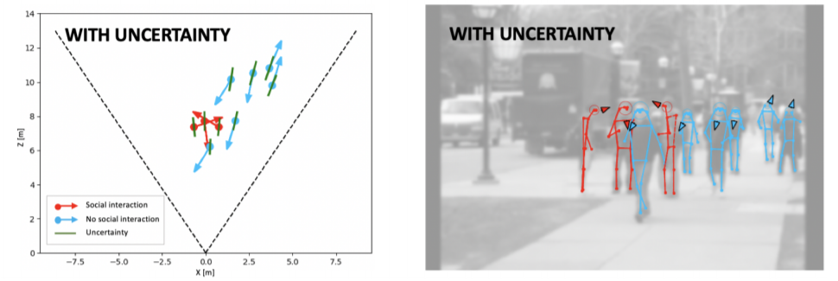
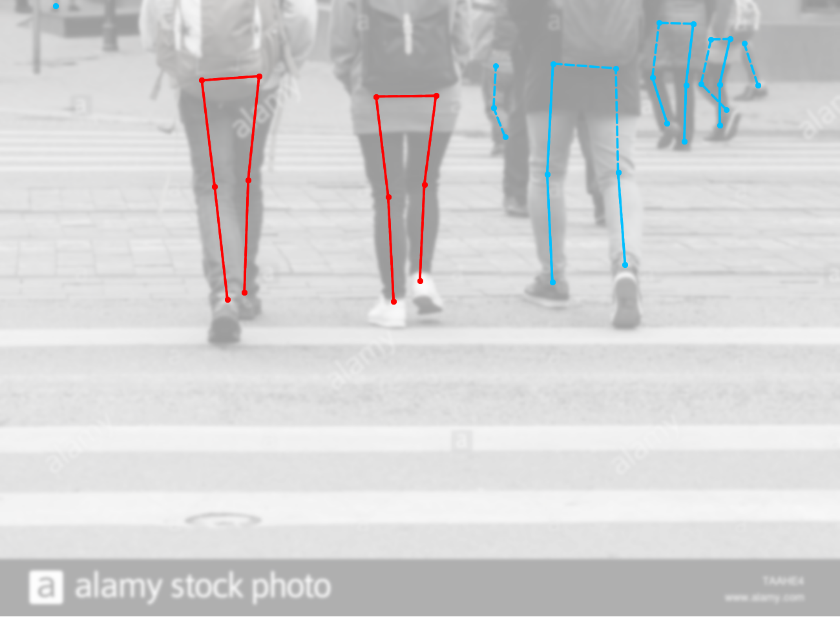
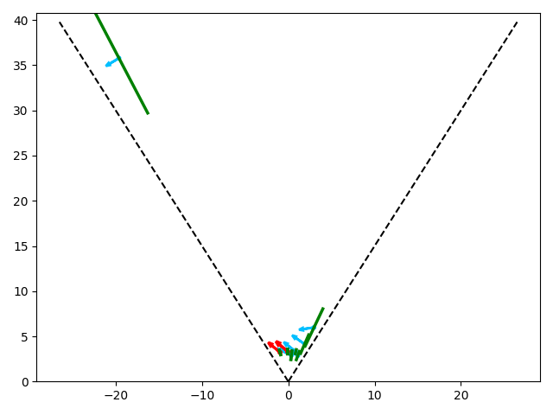
Perceiving Humans: from Monocular 3D Localization to Social Distancing
RGB camera
MonoLoco works in two stages. First it uses a 2D pose estimator to obtain2D joints from each person in the input image. Then the detected joints are inputted into a feed­forward network that outputs the 3D location information of each instance with a confidence interval.
Output when I ran the algorithm
The algorithm is not able to detect the skeleton and the output seems to be wrong
Output taken from the paper
Once a skeleton is detected the output seems to be better
For a pedestrian 20 meters far, the localization error is approximately 1 meter.
Notes:
2D joints are a meaning­ful low ­level representation which provides invariance to many factors, including background scenes, lighting, textures and clothes.

Slide 6
Deep Reinforcement Learning navigation
Mapless navigation systems can work with two different sensor types: i.e. laser sensors and vision based ones
Challenges faced:
Difficulty in finding the appropriate implementations for the papers
Decide on the hardware we will be using: Will we be using a LiDAR or should we just look at vision
What should be the approach taken for:
Navigating towards a goal- reach a specified destination
Avoid obstacles

